Slide 1
Regular Expressions in URLs

Slide 2
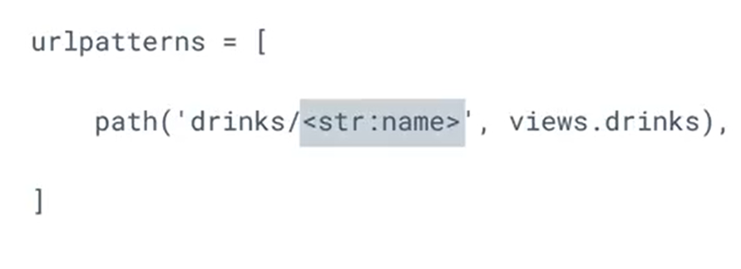
urls.py

Slide 3
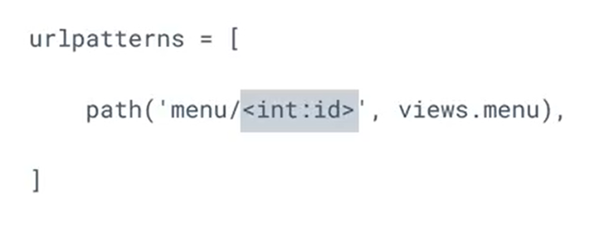
urls.py

Slide 4


Slide 5


Slide 6
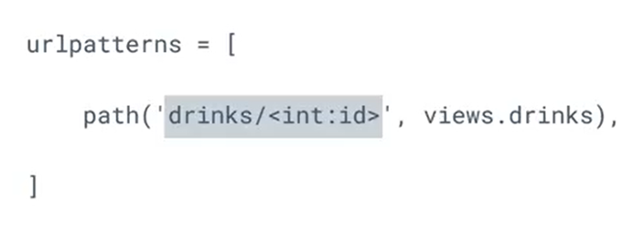
urls.py

Slide 7
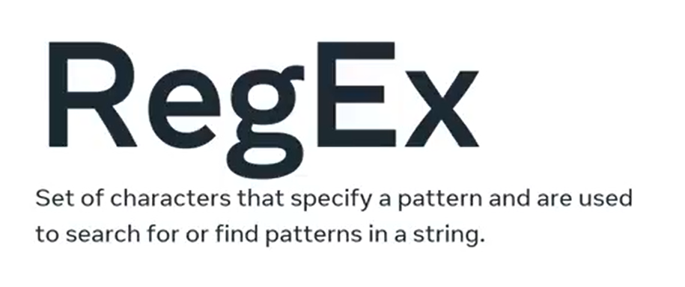

Slide 8
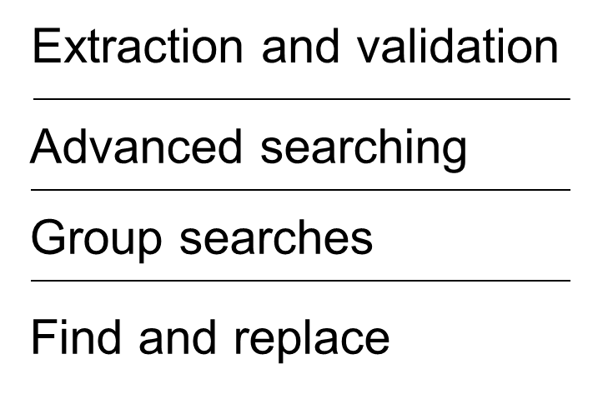

Slide 9

urls.py (app)

Slide 10


Slide 11
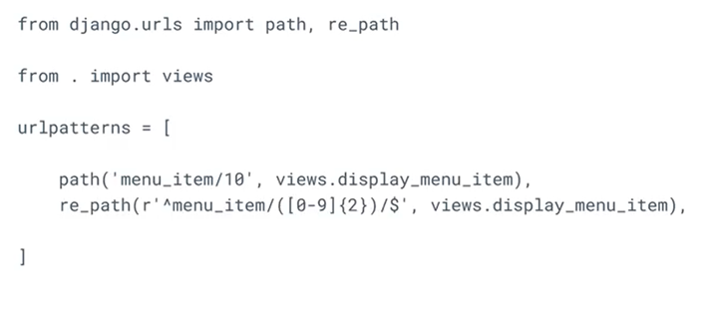
urls.py (app)

Slide 12
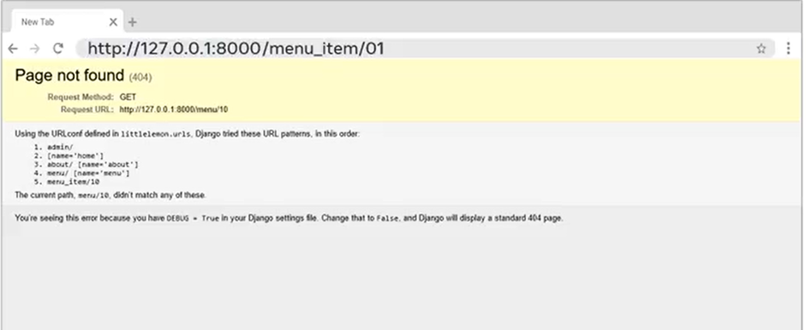

Slide 13


Slide 14


Slide 15


Slide 16
